Slide 2

WHIZZKID
By-
Prapat Jain
Veshnavi Sharma
Department Name- CEA
Institute -GLA university,Mathura
Date- 27 November 2023

Slide 3

INTRODUCTION
Online quizzing is a new and innovative way of taking quizzes that has revolutionized the traditional methods. With the advent of technology, online quizzing has become increasingly popular and is now widely used in educational institutions, businesses, and even for personal use. It provides a convenient and efficient way of testing knowledge and assessing skills.
The problem statement opted by us was to create an online quiz platform to let students try their hands on various topics. Our audience can try their hands on various exciting quizzes providing them with a vibrant interface to let participants have a real-time quiz experience.

Slide 4



OBJECTIVES
The main goal of Whizzkid is to educate users on various topics, assess their knowledge, and provide an entertaining experience. It also aims to engage users in a fun way, encourage competition, collect valuable user data, and foster a sense of community. Depending on the problem statement, the platform may focuses on learning, evaluation, entertainment, or we can say a combination of these objectives.

Slide 5

PROBLEM STATEMENT
We had to develop an online quiz platform that offers a user-friendly experience for taking various quizzes. The platform caters to educational and entertainment needs, allowing users to easily assess knowledge, engage in quizzes, and foster a sense of community.
The primary goals of Whizzkid is to engage users in interactive quizzes for educational or entertainment purposes. Whizzkid aims to facilitate learning, assess user knowledge and provide a user-friendly experience. Additionally, it may serve as a tool for skill development. Overall, the objective is to offer an enjoyable and informative experience for users.

Slide 6

Literature Review
There are several popular quiz websites cater to a diverse range of audiences, offering quizzes on various topics, including entertainment, education, and general knowledge . One of such website which is widely used in educational institutes is Quizizz.
Here are certain characteristics of Quizizz-
Focus: Educational quizzes for teachers, students, and learners.
Features: Gamified quizzes, live quizzes, and asynchronous learning options.

Slide 7

Methodology
HTML: Hyper-Text-Markup-Language is used forstructuring web pages over the internet. HTML is the language in which most websites are written. HTML is used to create pages and make them functional.
CSS: Cascading-Style-Sheet is a styling language used to style and basically define how the content will appear on the website. JavaScript: JavaScript is a scripting or programming language which is now used extensively to design modern web applications and
website, it allows the developer to write application which modify themselves according to each user and its data, this made web
applications much more accessible and suitable for many purposes.
. MongoDB: MongoDB is a popular NoSQL database that uses a document-oriented data model. Unlike traditional relational databases, MongoDB stores data in flexible JSON-like documents, which allows for greater flexibility and scalability.
ReactJS is a JavaScript library for building user interfaces, known for its component-based structure and efficient updates through a virtual DOM.

Slide 8

SYSTEM ARCHITECTURE
The overall architecture of the basic online quiz platform includes:
User Interface (UI): The front-end where users interact with the system. Authentication and Authorization: Manages user logins and permissions.
Quiz Management System: Allows quiz selection and storage of quiz-related data. Question Database: Stores a repository of questions for quizzes.
Quiz Engine: Manages quiz logic, question presentation, and user responses.
Results and Analytics: Records and analyzes user quiz performance. Communication Layer: Facilitates interaction between system components. Database: Stores user data, quiz content, and results.
External Integrations: Allows integration with external tools or platforms.
Interaction Flow:
Users log in, select quizzes, take quizzes and view results. The system ensures effective communication between components.

Slide 9
IMPLEMENTATION
1.Project Initiation
2. Needs Assessment
3. Planning and Design
4. Content Development
5. Development
6. User Interface and Experience (UI/UX)
7 User Engagement and Interaction
8.Deployment and Report Generation
9. Final Submission

Slide 10

FEATURES
The key features of our quiz platform project includes it’s ability to provide users with an interactive experience by giving them an opportunity to choose and prepare their concepts by attempting our various topic wise quizzes along with a feature of comparing their answers with the correct ones at the end which would help them learn efficiently for better test results.

Slide 11
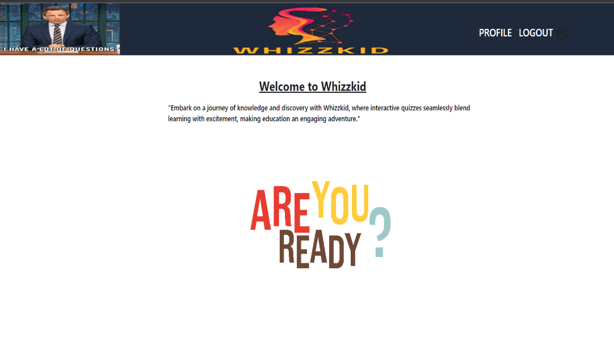
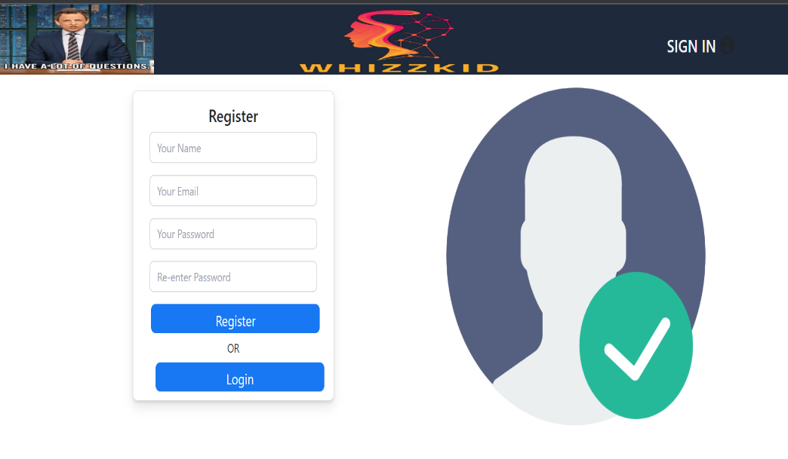
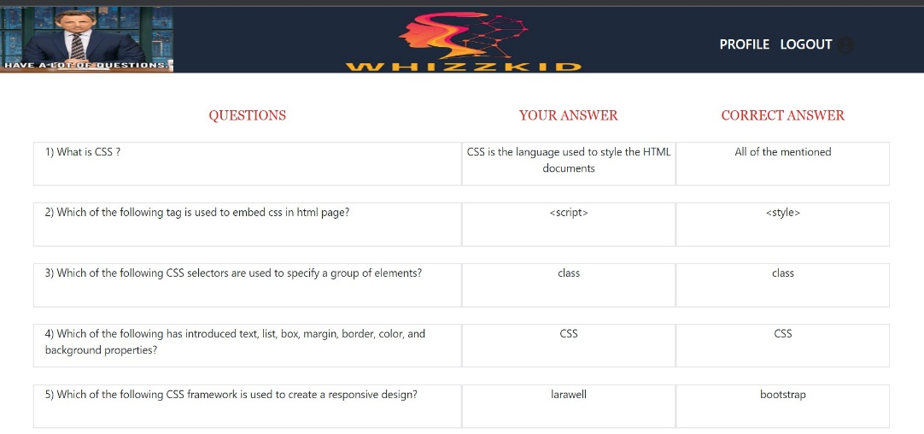
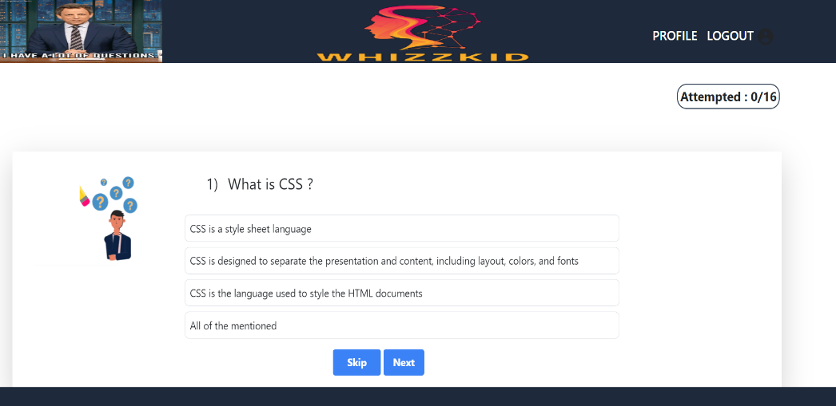
RESULTS

Slide 12

Challenges Faced
We did encounter certain challenges while developing our project like we had issues with
our backend programming and while working with new technologies like ReactJS.
We visited various tutorials on Youtube and referred to other free resouces. Also we referred to our seniors who helped us in the backend development mongoDB and also helped us in brushing up our front-end development skills.

Slide 13

Future Work
In order to extend the functionality of this project in future we can set the focus of this platform on customization and personalization. Users will empowered to become creators themselves, enabling them to craft and share quizzes tailored to their unique interests and educational goals. This personal touch will not only enhances the user experience but will also foster a dynamic and interactive environment.There are certain other features which can be added further to extend it’s functionality in future-
AI-Powered Features:Integrating artificial intelligence (AI) for features like automated question generation, intelligent feedback, or predictive
analytics to further enhance the platform's capabilities.
Localization and Internationalization:Expanding language support and adapting the platform to different cultural contexts to reach a more diverse user base.
Gamification Elements:Adding more gamification elements, such as badges, leaderboards, or virtual rewards, to motivate users and foster a competitive yet collaborative learning environment.
Feedback Mechanisms:Implementing advanced feedback mechanisms, including sentiment analysis, to understand user satisfaction and gather
insights for continuous improvement
.Offline Capabilities:Developing offline capabilities, allowing users to download quizzes and content for offline use, catering to scenarios where internet connectivity is limited.

Slide 14

CONCLUSION
In wrapping up our college project on the online quiz platform, we’ve built a user-centric digital environment that promotes learning and self-assessment. The platform provides a wide range of quizzes, log-in options and secure data handling to accommodate students who are eager to learn and enthusiastic. We also aim to deliver the project by keeping in mind all the necessary requirements and deadlines to our project supervisor as an authentic requirement of our work for this particular semester

Slide 15

Acknowledgments
As we reach the end of our presentation, we would like to thank our mentor Mr. Mayank Saxena for supporting us throughout and always guiding us wherever we lacked. Also we would like to thank the CEA department for providing us with an opportunity to showcase and enhance our skills with this enriching hands-on experience of creating a real-time quiz platform

Slide 16

Any Questions? Ask away.

